Slide 1
FACE TRACEABLE REVOLVING CAMERA

Slide 2
PRESENTED BY
Zaima Zarnaz
1607090
Dipannita Biswas
1607072

Slide 3
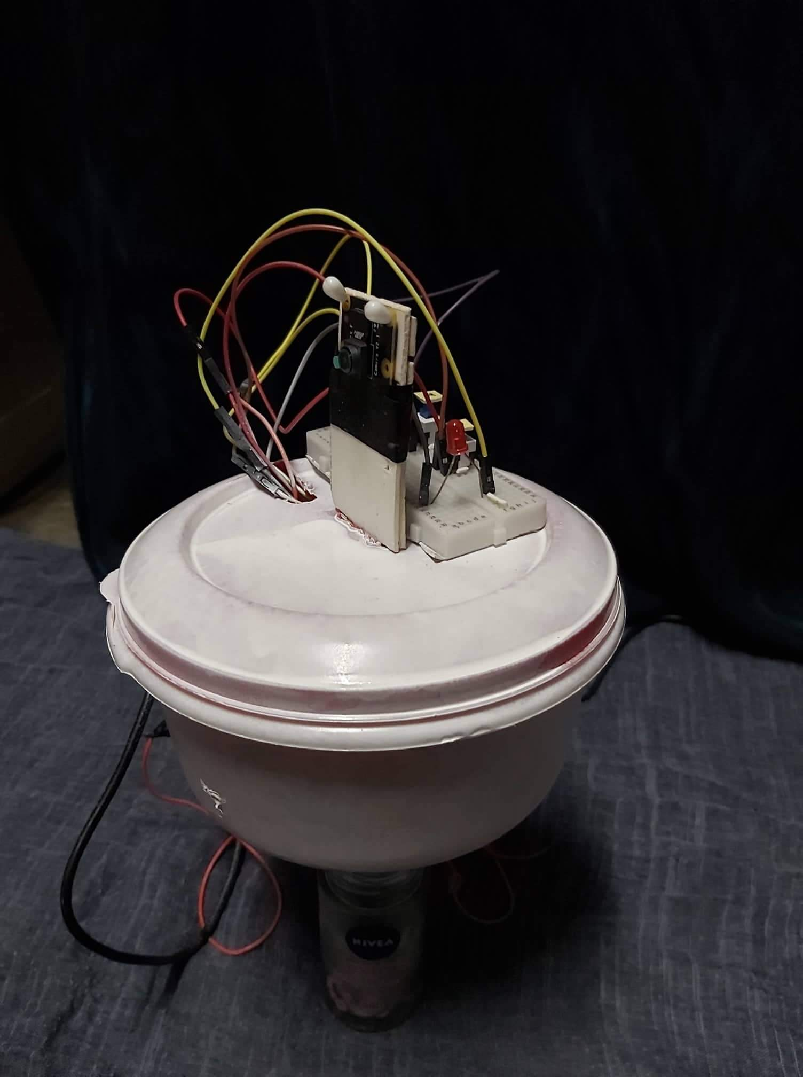
Manually controlling smooth rotation of a camera during live recordings can often be extremely difficult, especially in critical, hectic or dangerous environments.
The objectives of building this project are to eliminate the need for a third party cameraman and to fully automate the process of video recording. Using our system the possibility of human errors like shaky camera recording and rough movements or rotations can also be eliminated.

Slide 4
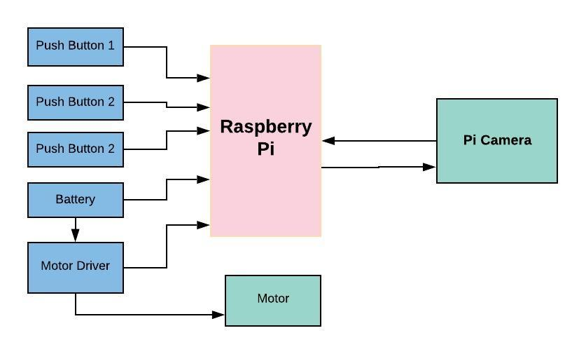
HARDWARE DESIGN

Slide 5
FEATURES
Face detection
Face tracking
Regulating motor position
Live streaming video to web

Slide 6
FACE DETECTION

Slide 7
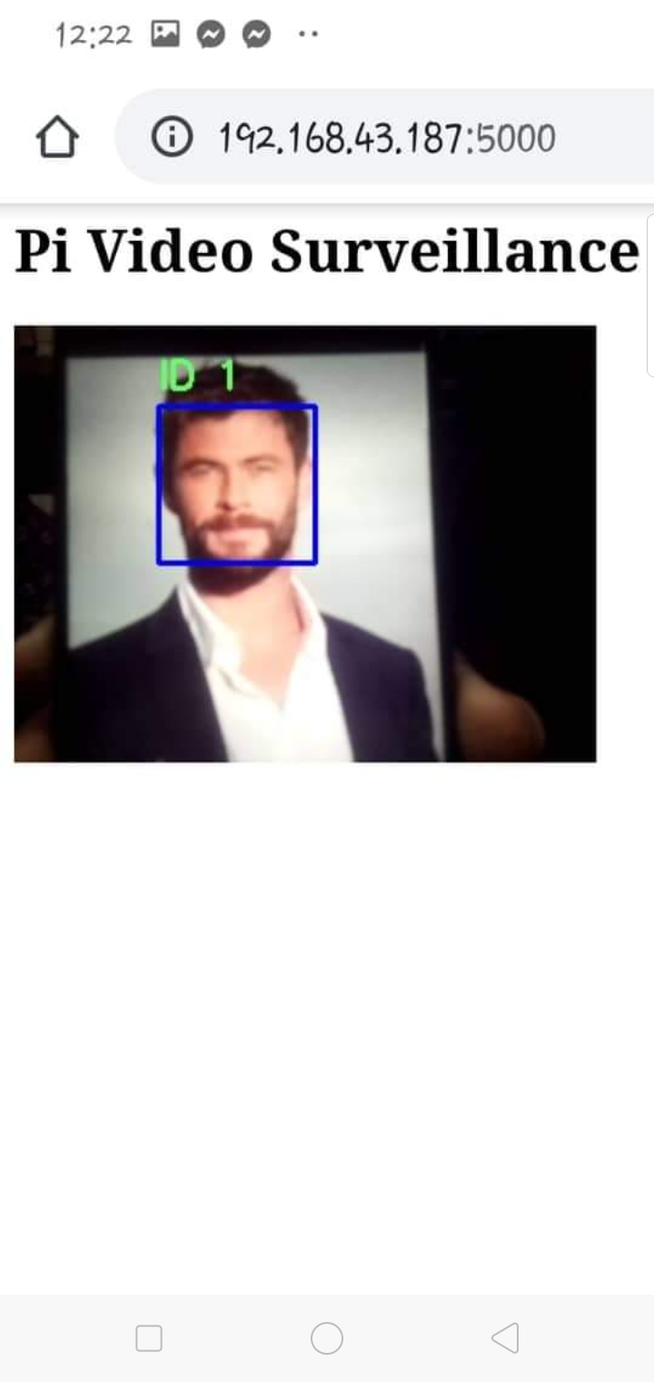
Using Opencv library, face detection is applied individually to each frame
A sliding window moves across the entire frame from left to right
At each stoppage the window scans the box for a face by extracting Haar-like features from the image.

Slide 8
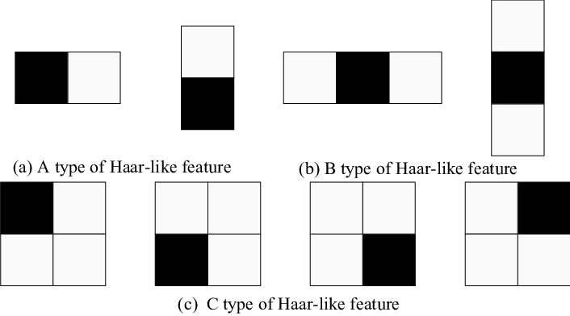
HAAR LIKE FEATURES
Haar like features are a sequence of rescaled square shaped functions used in face detection

Slide 9

VIOLA JONES ALGORITM
The value of delta is characterized by the difference
Between the cumulative intensities of the dark and light
Pixels in a window.
The closer is the value of delta, the higher is the probability
of finding a Haar-like features in the image

Slide 10
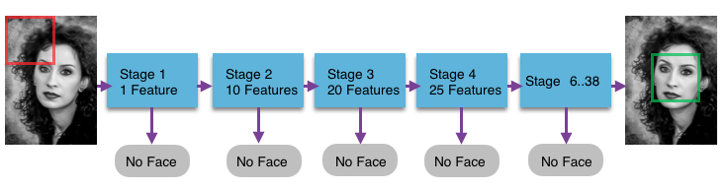
CASCADED HAAR CLASSIFIERS

Slide 11
FACE TRACKING

Slide 12
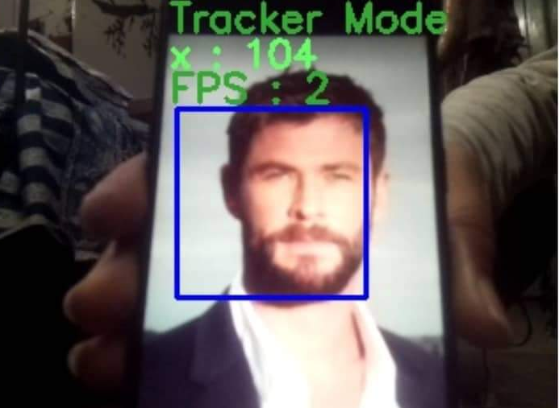
The desired face, after being select by the push button can be accurately tracked by the pi. For convenience of the user, we included the horizontal position of the face at the top of each frame.
OpenCV allows 8 built-in tracking algorithms that uses appearance model which is actually is a classifier that is trained in an online manner. The algorithms are – Boosting00, MIL, KCF, TLD, Medianflow, GOTURN, MOSSE or CSRT.
Among we used TLD algorithm for our project.

Slide 13
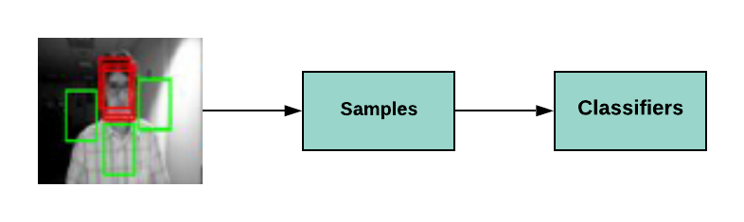
TLD Tracking Algorithm
STEP 1:The whole frame is divided into sub-windows . Then, it detects the targets resembling those in target feature. It selects those who matches the target feature as positive windows and others as negative windows.

Slide 14
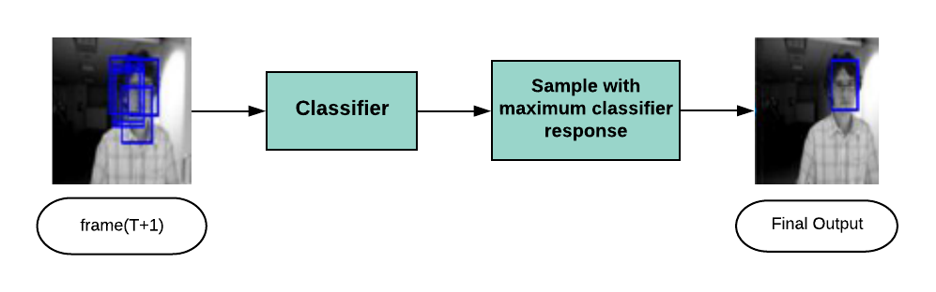
TLD Tracking Algorithm
STEP 2:Using the Naive Bayes classifier, the window with the highest classification score is regarded as the target window. This achieves the target tracking from the t frame to the t+1 frame.

Slide 15
REGULATING MOTOR ROTATION

Slide 16
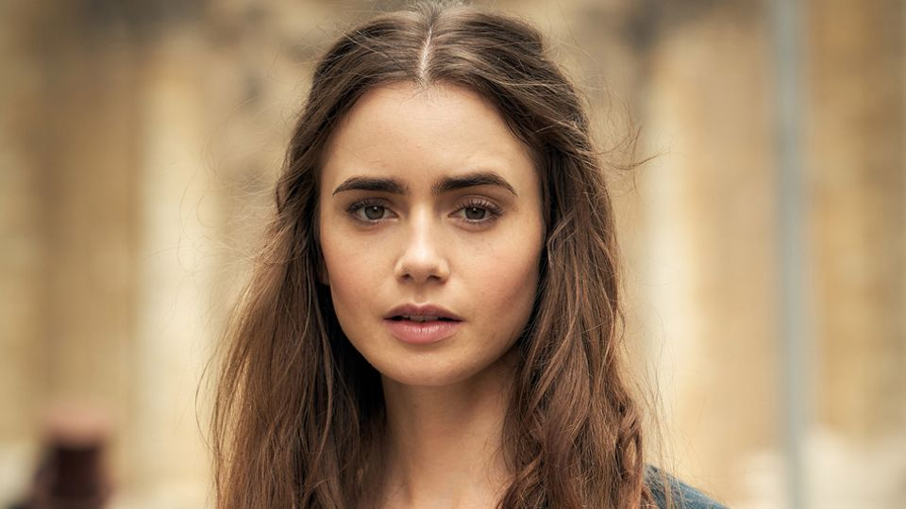
The motor continuously strives to keep the requested face at the center of the image
A horizontal boundary for the frames is predefined
The TLD tracker continuously informs the pi about the location of the requested face.
This location determines the magtitude and direction of the rotation of the motor
Left boundary
Right boundary

Slide 17
MOTOR ROTATION
STEP 1
The tracker function locates the selected image in the frame and returns the X co-ordinate of the bounding box .
STEP 3
if the face has crossed the left limit, the motor turns left. If it has crossed the right limit the motor turns right for the calculated duration. Otherwise it remains stationary
Position Setting Process
STEP 2
The pi checks to see if the position of the selected face is within the pre-defined boundary region. If not, it calculates the duration of rotation.

Slide 18
LIVE STREAMING VIDEO TO SERVER

Slide 19
We used Flask, a micro web framework for the Python programming language to video stream to web browser.
First we encode the frame as a JPEG image then serve the encoded JPEG frame as a byte array that can be consumed by a web browser.
To launch the flask we need 3 parameters : ip address where we are launching our python program , port number where Flash will run and frame count to build background model before detecting.

Slide 20
WORKING FLOWCHART

Slide 21
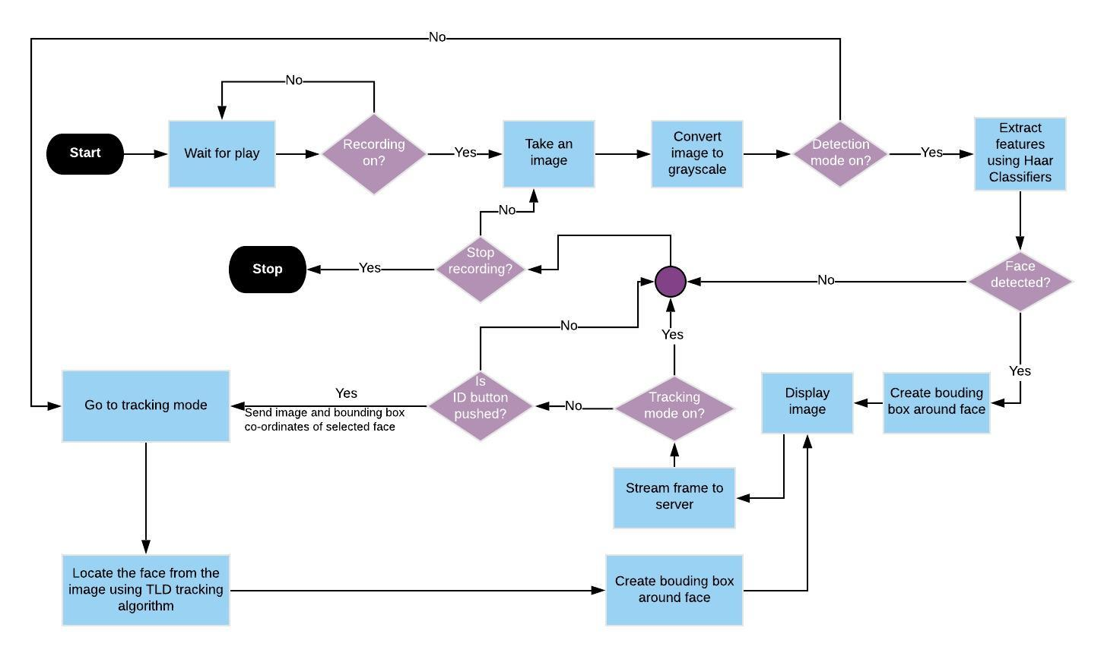

Slide 22
THANK YOU

